Slide 1





Fast Tile-Based Adaptive Sampling With User-Specified Spectra
Florent Wachtel¹ – Adrien Pilleboue¹ – David Coeurjolly² – Katherine Breeden³ – Gurprit Singh¹ – Gaël Cathelin¹ – Fernando de Goes⁴ – Mathieu Desbrun⁴ – Victor Ostromoukhov^{1,2}
1
2
3
4
Notes:
Good morning everyone.
I'll present a novel tiled-based sampling method that can generate point distributions with arbitrary user-specified spectra.
This work is the result of collaboration of people from the French lab CNRS-LIRIS, Stanford and Caltech.

Slide 2
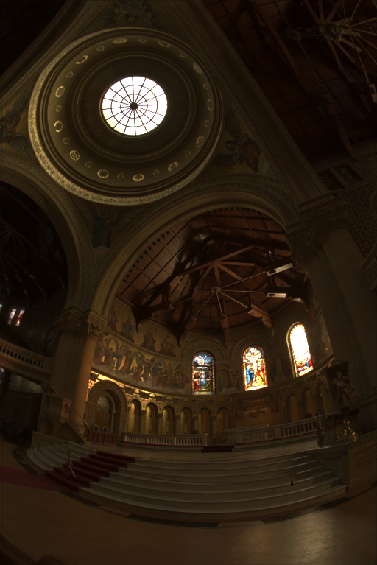
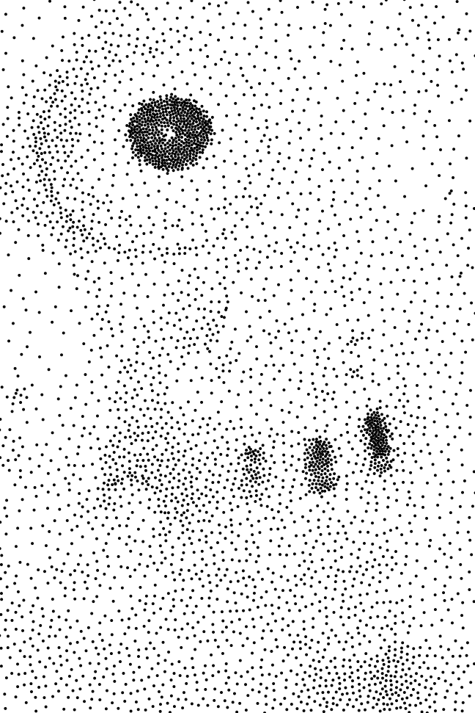

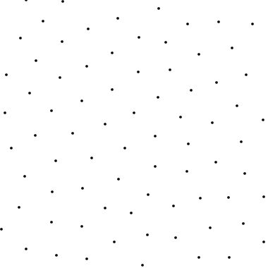
Problem Statement
Find a discrete sample distribution with density locally proportional to d(x, y)
Given a density function d(x,y)
courtesy of P. Debevec
Notes:
Put simply, sampling is the process of discretizing a continuous function.
Intuitively, we want the samples to be evenly distributed, and potentially, to have a local density of samples proportional to the local value of the function.
& When these samples are then used in techniques such as reconstruction or integral approximation, the nature of their distribution will have a big impact on the quality of the results.

Slide 3
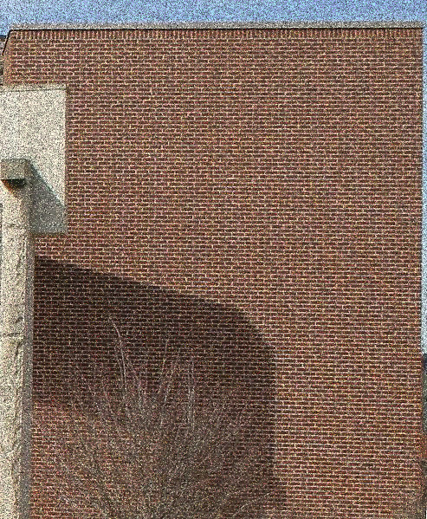
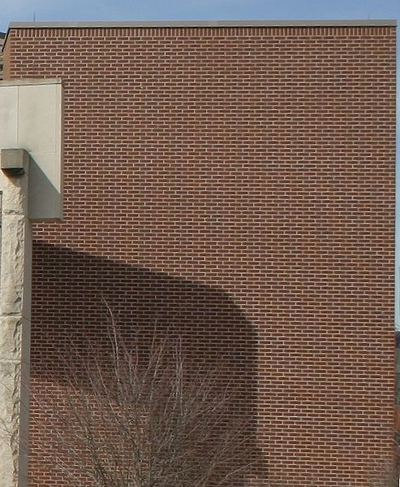
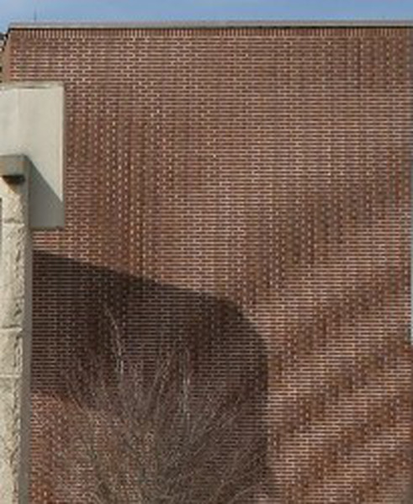
Why it is essential?
Two main issues when sampling a function:
Noise = not enough samples
Reference
Aliasing = sampling pattern
Notes:
For example, as shown on the left, local sparseness of samples generates a noisy reconstruction.
====
Another issue can be aliasing, which results from the interference between regularities in sampling and regularities in the function.

Slide 4

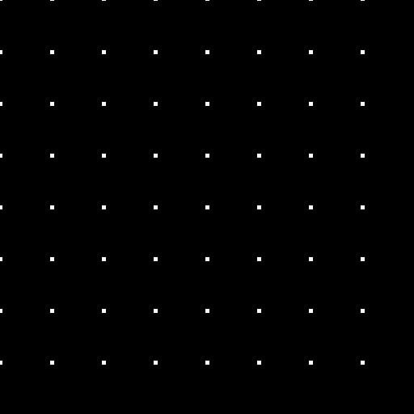
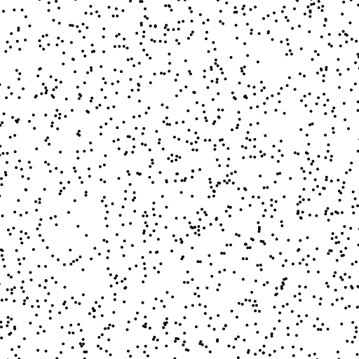
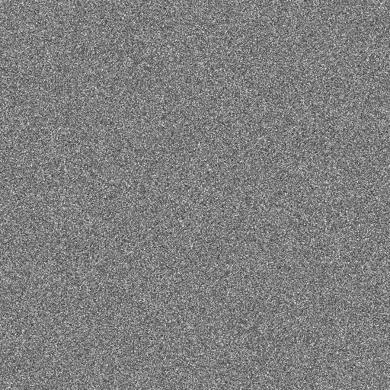
Context
Regular Sampling
Random Sampling
Pro: Uniform
Con: Aliasing when sampling frequency is below Nyquist frequency
Pro: No regularity
All frequencies equally sampled
Con: Voids and Clusters
Distribution
Fourier Spectrum
Distribution
Fourier Spectrum
Notes:
The simplest way to generate sample positions is to calculate a rectangular grid.
This method has the advantage of sampling the whole space uniformly.
But it produces strong aliasing artifacts when the sampling frequency is smaller than twice the maximum frequency of the function.
====
Another simple solution is to choose the position of each sample at random.
In this type of distribution, all frequencies are equally sampled, as indicated by the constant Fourier spectrum.
However, this distribution doesn't guarantee a local uniformity, as you can see by the presence of local voids and clusters of samples.
This will lead to noisy images after reconstruction or integration.

Slide 5

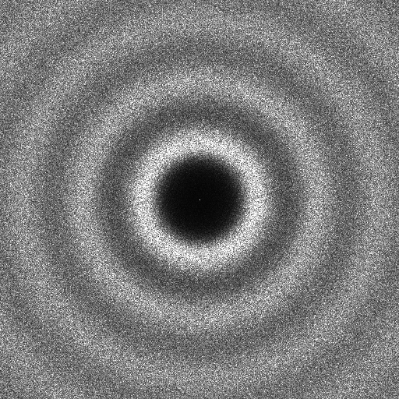

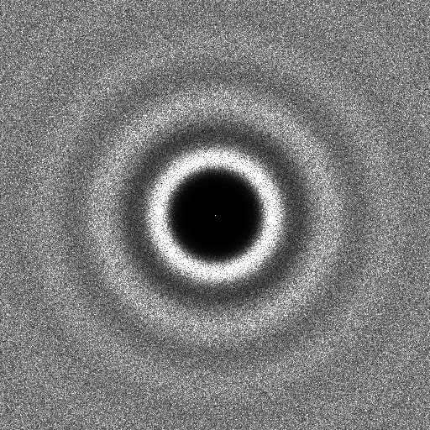
Previous work: Advanced Methods
Poisson Disk Methods
Optimization-based Methods
Stochastic
Force uniformity with exclusion disk
[Cook 1986][McCool et al. 1992][Wei 2008]
Minimize energy function
[Balzer et al. 2009][Fattal 2011]
[Schlomer et al. 2011][de Goes et al. 2012]
Distribution
Fourier Spectrum
Distribution
Fourier Spectrum
Notes:
Since the nineteen-eighties, many algorithms have been proposed to enhance sampling quality given a constant number of samples.
In Poisson Disk methods, a random sample position is chosen, while respecting constraints on minimum allowed point-to-point distances.
This method guarantees much better uniformity when compared to random sampling.
====
Some other methods are based on optimization.
The core of these methods is the minimization of an energy function associated with the samples.
Currently, the best-quality sampling distribution are obtained with this kind of methods.
Such distributions and spectra are known as blue-noise, which is very popular in computer graphics.
Notice that for both kind of methods, there are no frequency peaks in the spectral domain, thus limiting aliasing artifacts.
& While these methods aim to generate distributions with superior blue-noise spectra, there are instances in which we may need other types of distributions.

Slide 6

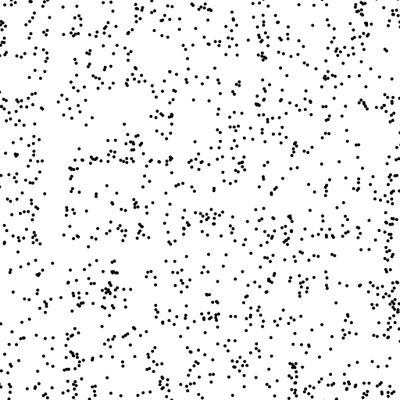
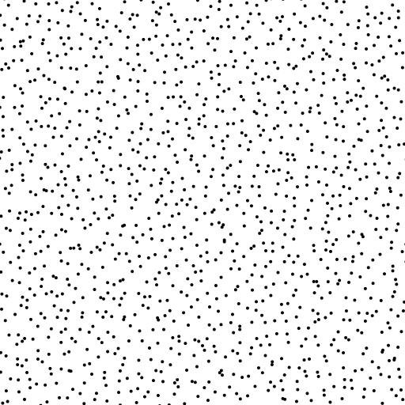
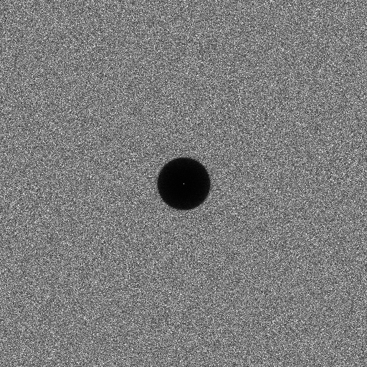
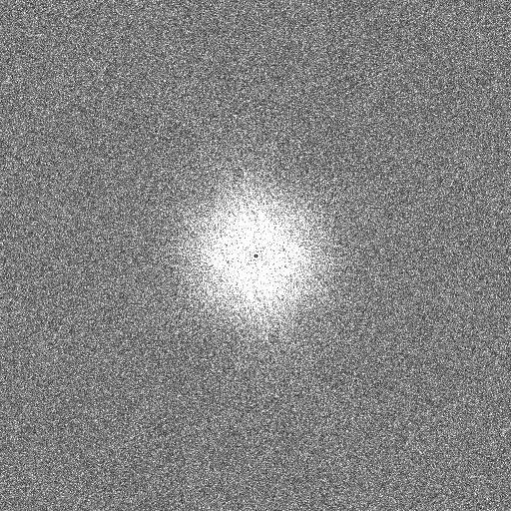
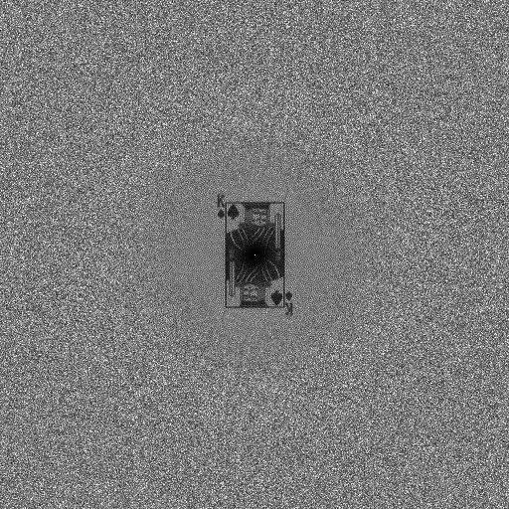
Previous work: General Noise Methods
Each application requires its own spectral characteristics
[Wei et al. 2011][Zhou et al. 2012][Oztireli et al. 2012][Heck et al. 2013]
Step noise
Pink noise
King noise
Distribution
Distribution
Distribution
Fourier Spectrum
Fourier Spectrum
Fourier Spectrum
Notes:
In the last two years, new methods have been proposed to generate sampling distributions with user-specified Fourier spectra.
They allow for the generation of distributions with the best properties needed for particular applications.
& Unfortunately, most of these advanced sampling methods are not suitable in practice, due to their complexity and runtime speed limitations.

Slide 7
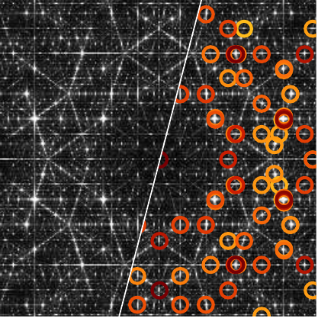
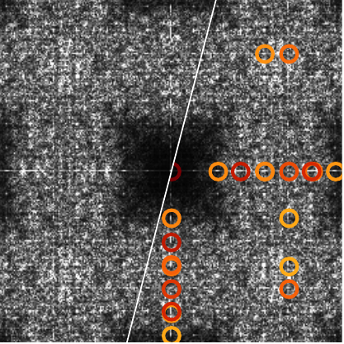
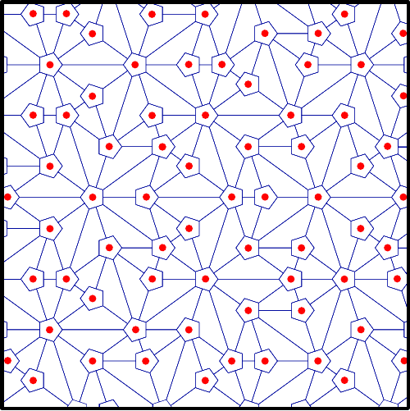
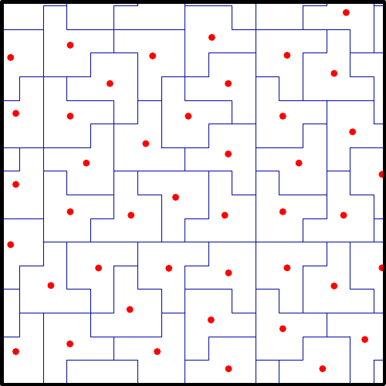
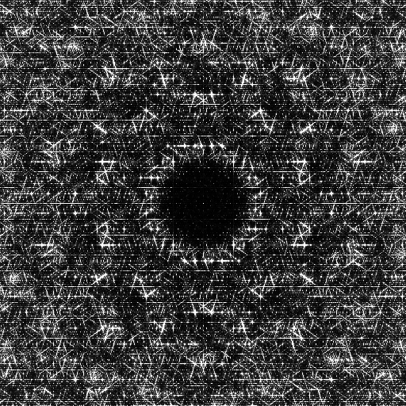
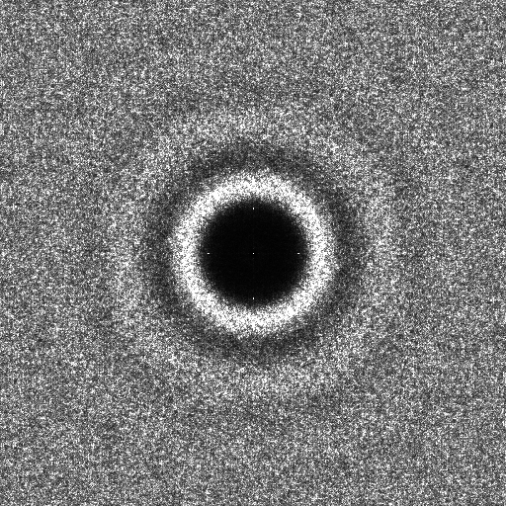
Previous work: Tile-based Methods
Store precomputed samples in a hierarchical and non-periodic tiling system
[Ostromoukhov et al. 2004, 2007] [Kopf et al. 2006] [Lagae et al. 2006]
Penrose Tiling
Polyominoes Tiling
before optimization
before optimization
Fourier Spectrum
Fourier Spectrum
after optimization
after optimization
Distribution
Distribution
Notes:
Tile-based methods aim at reducing sampling generation complexity while producing sufficiently good sampling distributions.
These methods are build in two steps:
First, a hierarchical and non-periodic tiling system is construct, where tiles’ barycenters forms a basic sampling.
Second, the sample position are optimized to obtain a better sampling distribution.
And the offsets vectors are then stored in a lookup table.
The tilings shown in this slide come from previous tile-based methods and the red dots indicate the barycenters of each tile.
The Fourier spectrum of these barycenters contain a lot of peaks, highlighted with circles.
They express patterns and regularities in these tilings.
====
Even after the optimization of the samples' positions, spectral peaks still remain because of the inherent regularities of the tiling.
& This is the main problem we address in this work.

Slide 8
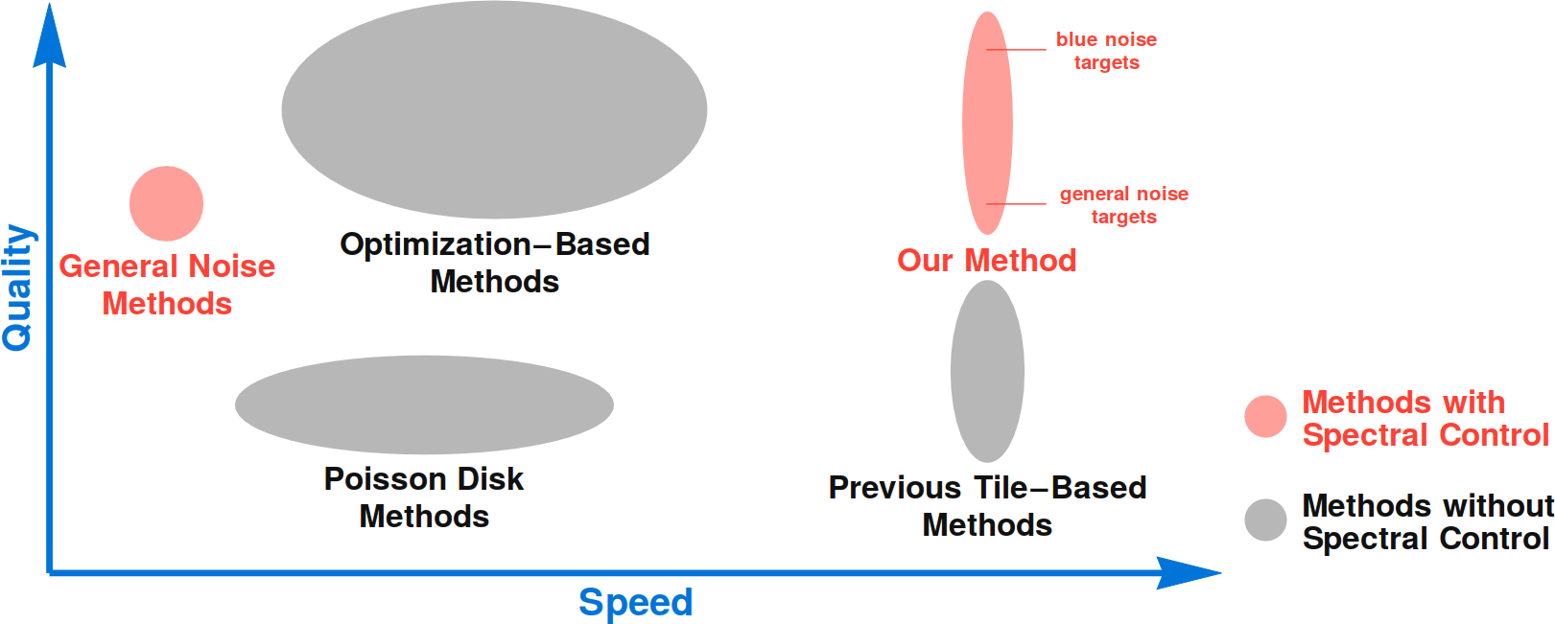
Previous work: Positioning
Notes:
We propose a sampling method that overcomes the drawbacks of previous tile-based methods
and that can generate sampling distributions of equivalent quality than the best state-of-the-art sampling methods.
As with General Noise methods, we can also produce distributions with user-specified Fourier spectra.

Slide 9
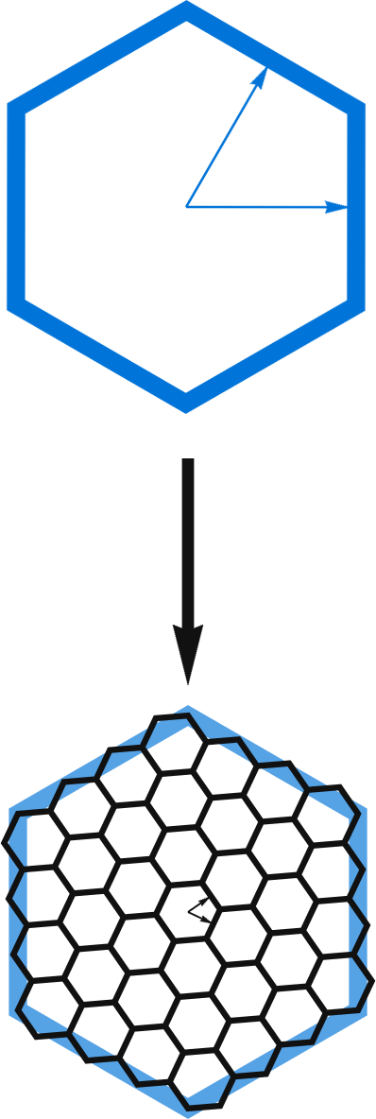
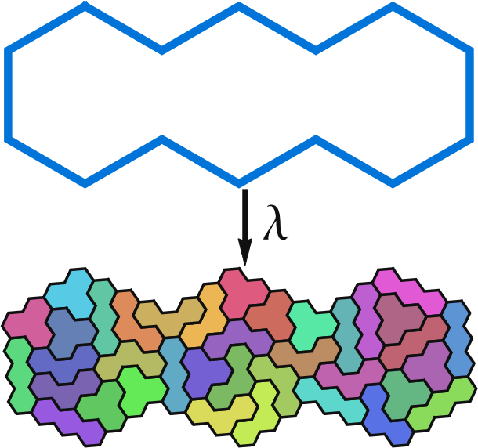
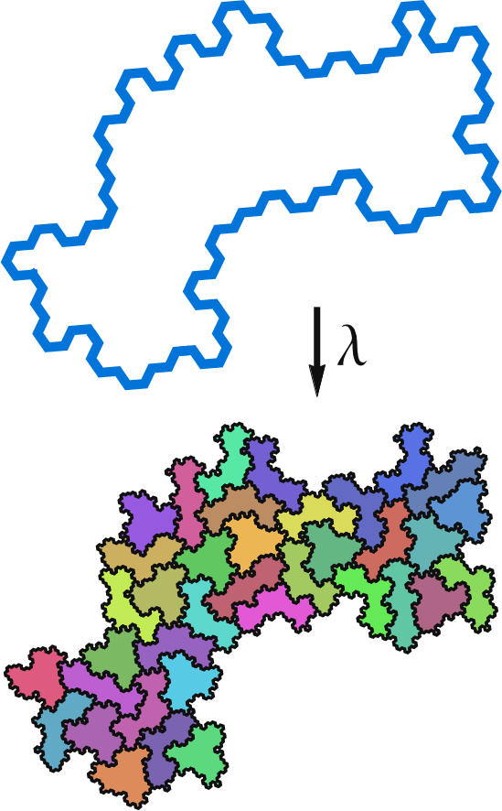
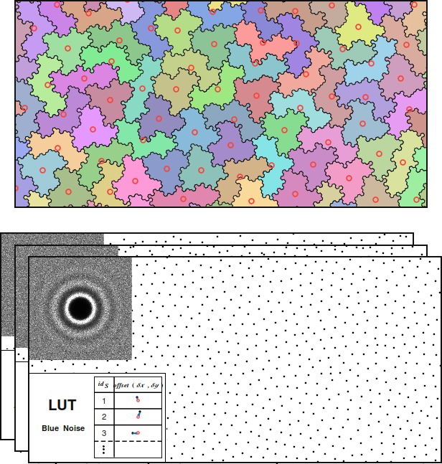
Outline
Hierarchical Tiling
Non-periodic Tiling
No pattern/regularities
Spectral control
Notes:
To achieve this goal, we need a hierarchical tiling system
====
that is non-periodic
====
and free of strong regularities.
====
Also, this tiling must support a sampling system with spectral control.

Slide 10
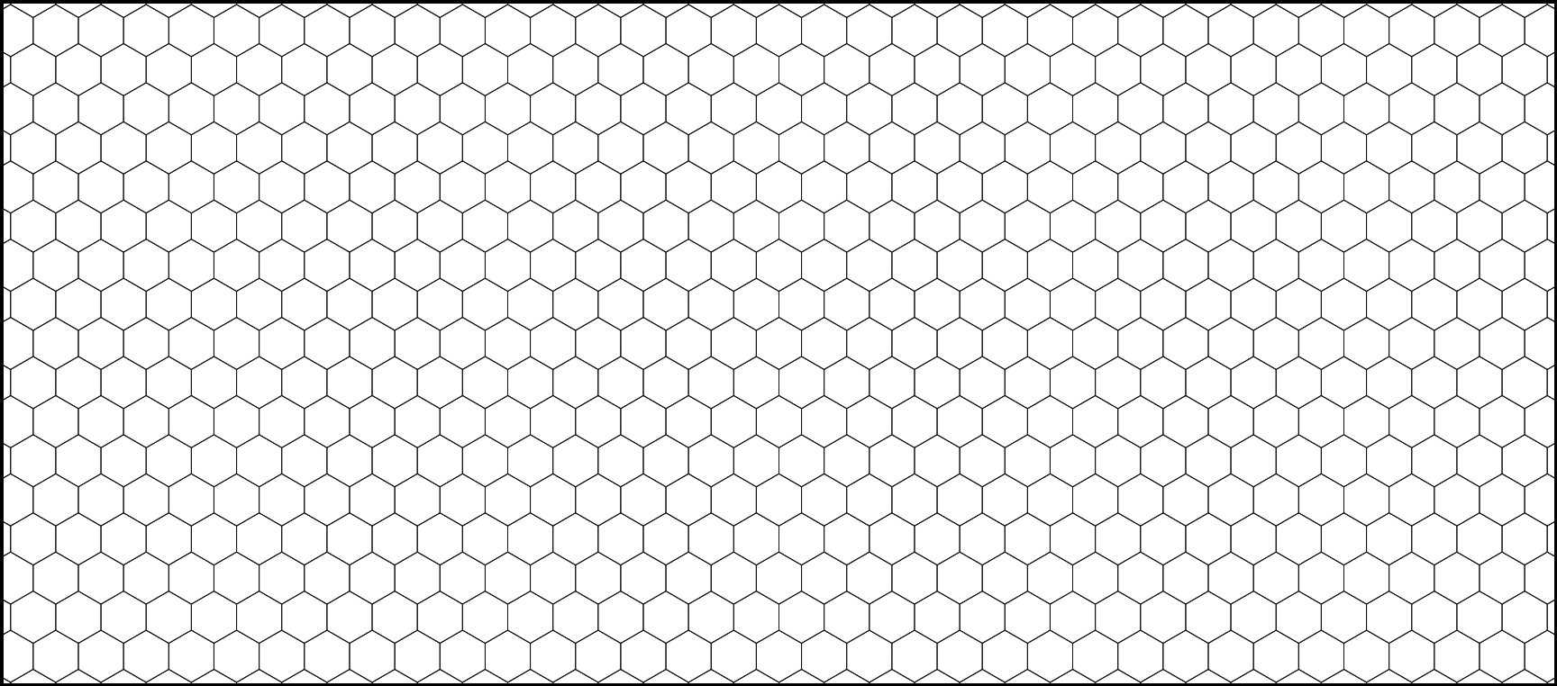
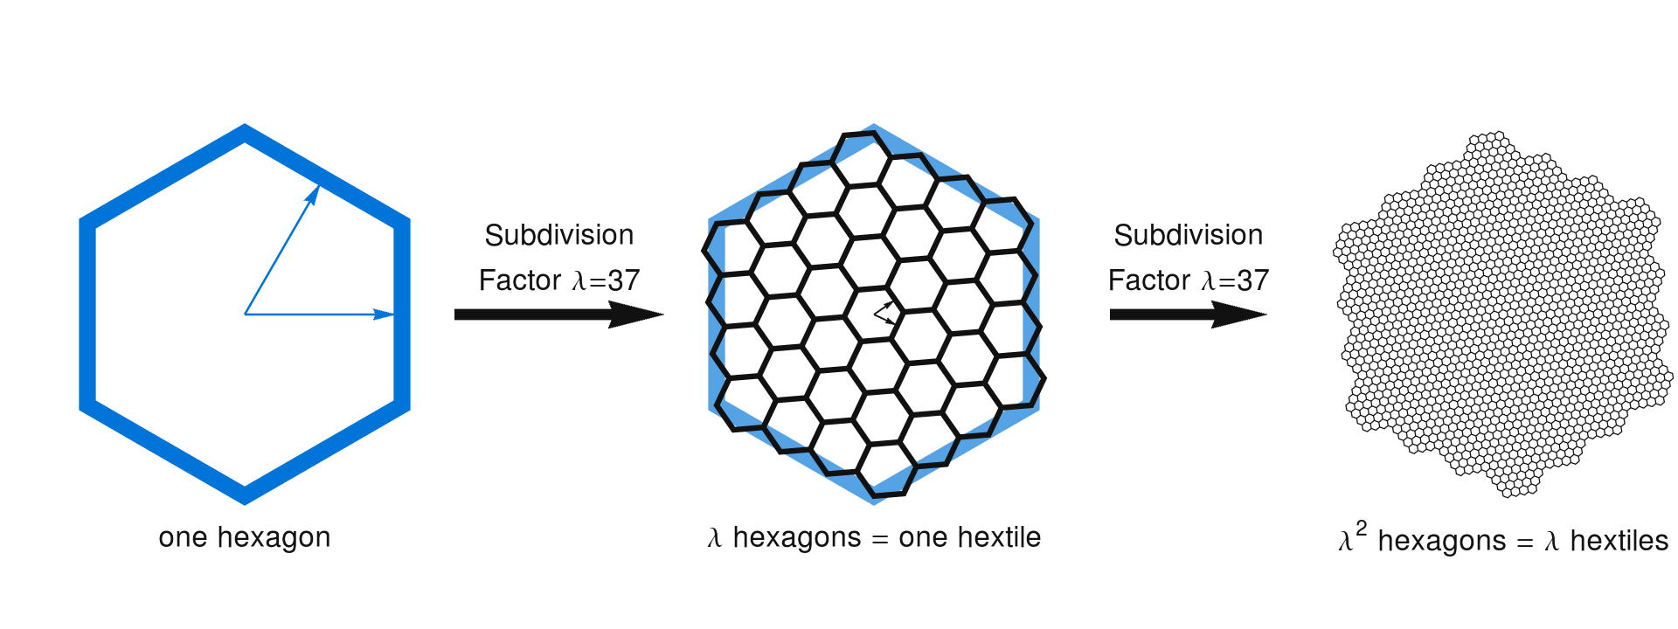
Base lattice
Hexagonal lattice
Recursive subdivision scheme
Notes:
The building blocks of our system are hexagons, which provide better anisotropy and simpler connectivity than squares.
These hexagons can be recursively subdivided into smaller hexagons, thus densifying the underlying lattice.
& This hexagonal lattice is then used to build a more complex hierarchical non-periodic tiling system.

Slide 11
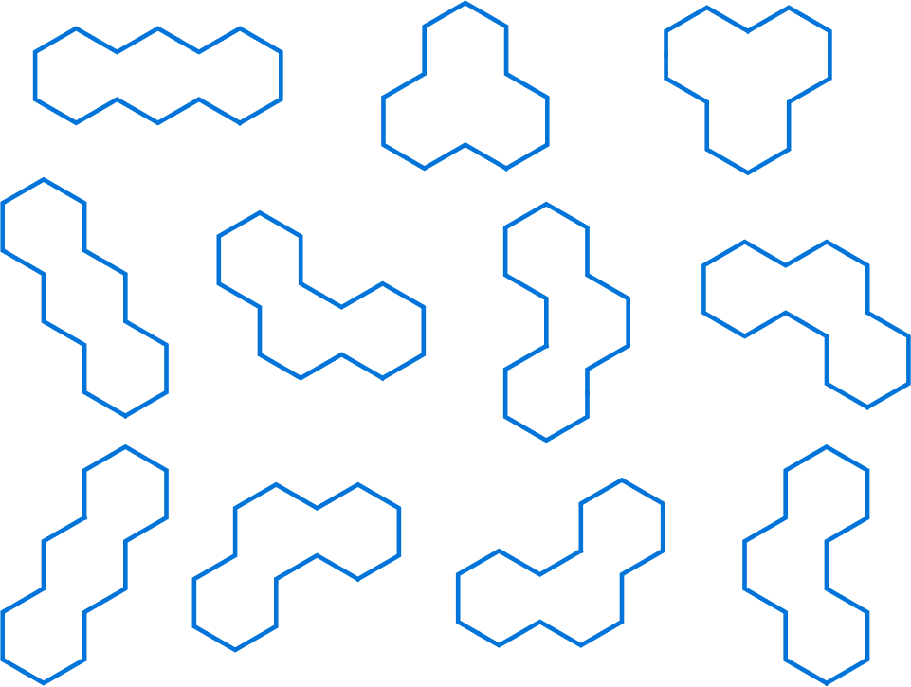
Polyhexes & Subdivision
11 possible trihexes
Subdivision rule for each trihex
Notes:
To construct this system, we group hexagons into connected triplets, which are called trihexes.
We then enumerate all possible geometric configurations, as shown here.
====
Within each trihex, the constituent hexagons are subdivided and clustered into further trihexes.
You can find more details about this step in the paper.
& These rules form a closed and finite subdivision system that can produce a hierarchical and non-periodic tiling.

Slide 12
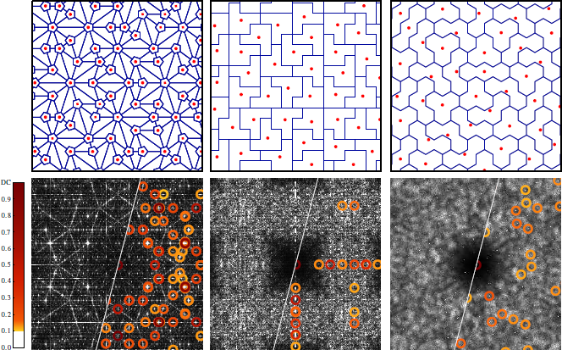
Comparison with previous systems
Penrose
Polyominoes
Trihexes
Notes:
The Fourier spectrum of this tiling is more isotropic than previous tile-based methods.
This is due both to the hexagonal lattice and to a greater variety of tiles.
But we still have small spectral peaks and regularities, as shown with red circles.
Because our tiling is generated by applying a recursive subdivision scheme, that retain each tiles’ borders, some alignments will arise on the borders of the previous levels of tiles.
This is enough to generate small but still harmful spectral peaks.

Slide 13
Irregular quasi-hexagonal lattice
Start from a standard hexagonal lattice
Notes:
To overcome this issue we define a new lattice … (from group of hexagons called hextiles.)

Slide 14
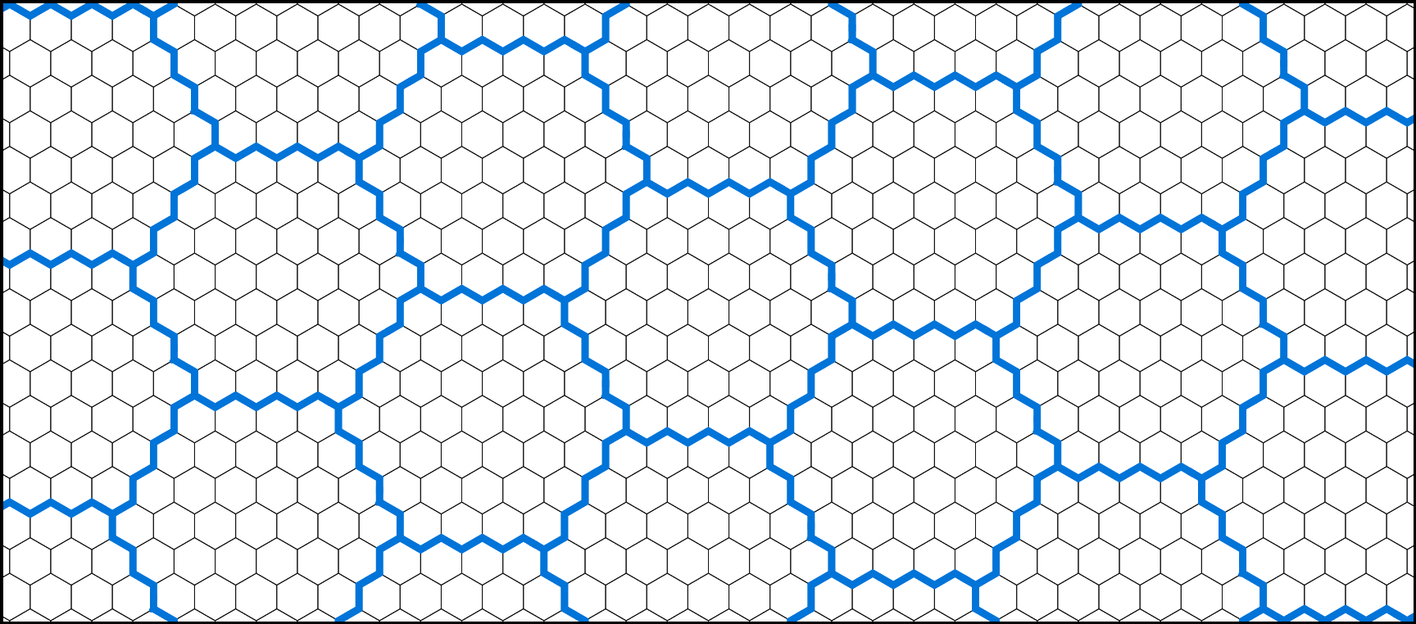
Irregular quasi-hexagonal lattice
Construct a quasi-hexagonal lattice of hextiles
Notes:
… from group of hexagons called hextiles.

Slide 15
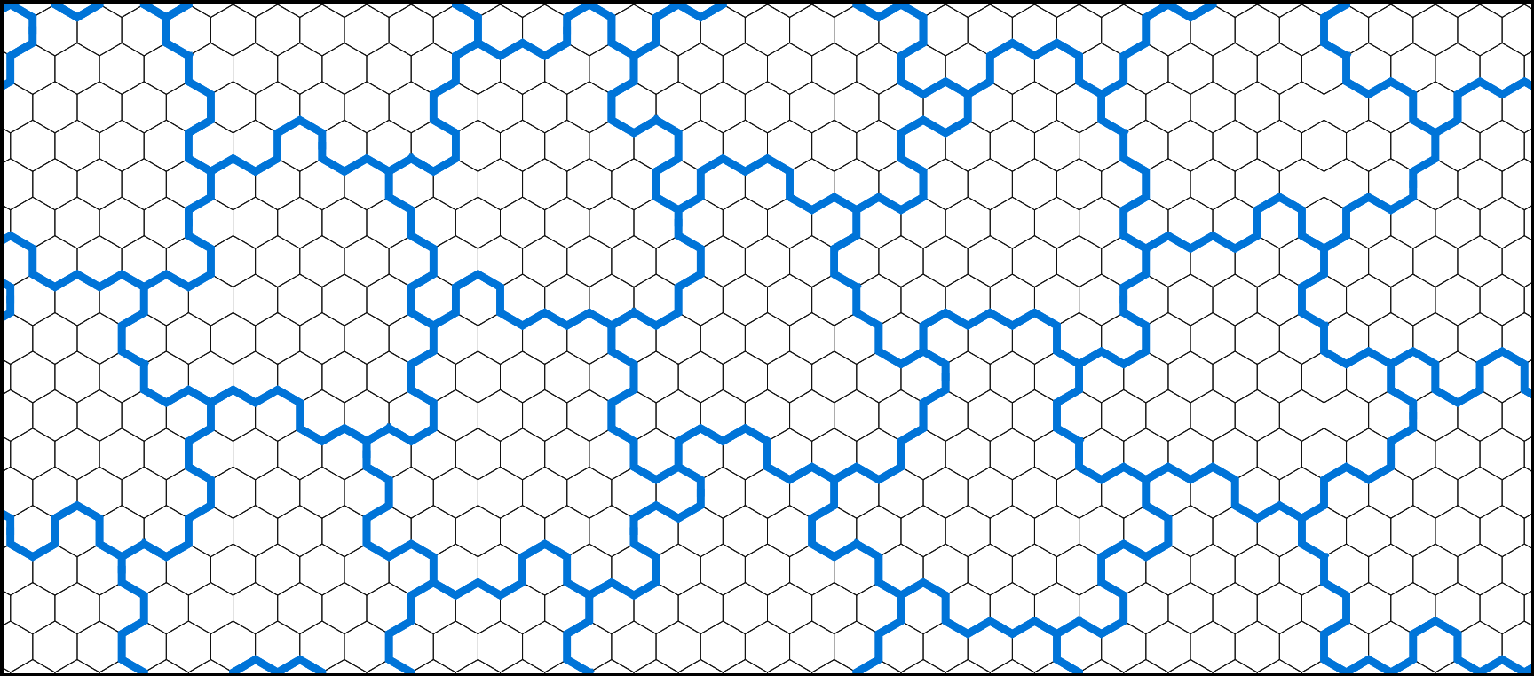
Irregular quasi-hexagonal lattice
Transformed in a quasi-hexagonal lattice of irregular hextiles
Notes:
These hextiles will be randomly perturbed at each subdivision to eliminate the regularities in the tiling.

Slide 16
Irregular quasi-hexagonal lattice
Notes:
To shuffle the hextiles borders while keeping their capacity … (we first consider triple-edge modifiers comprised of three connected borders.)

Slide 17
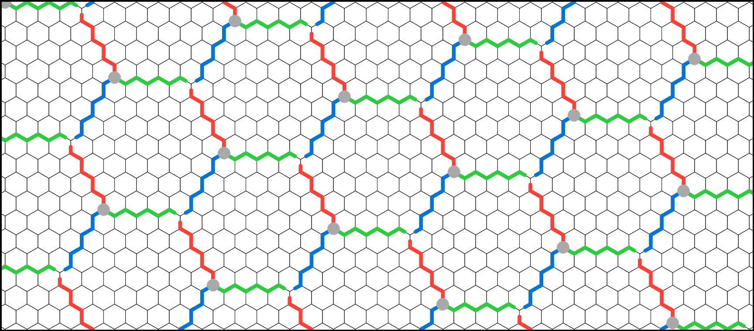
Irregular quasi-hexagonal lattice
Reassign hextiles borders to obtain triple-edge modifiers
Notes:
… we first consider triple-edge modifiers comprised of three connected borders.

Slide 18
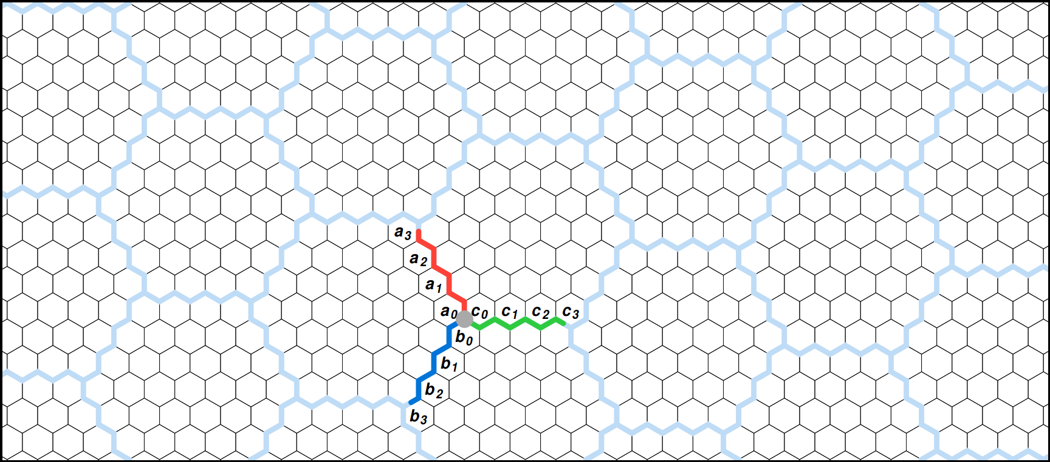
Irregular quasi-hexagonal lattice
A triple-edge modifier is defined by 3 binary words (A,B,C)
Notes:
Each of these triple-edge modifiers is characterized by three binary words.
A one bit in these words induces a local modification of the corresponding hextile border.

Slide 19
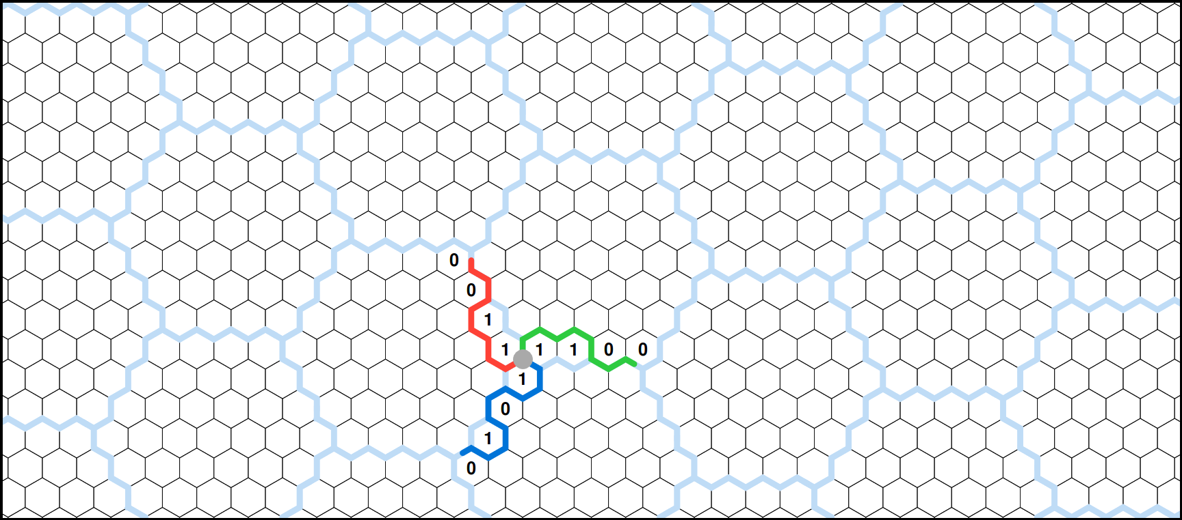
Irregular quasi-hexagonal lattice
These words are randomly set with an equal number of positive bits
Notes:
A stochastic process randomly selects these binary words from a set of admissible triple-edge modifiers.
Such admissible set enforces the preservation of the underlying hextile tiling.
You can find more details in the paper.

Slide 20
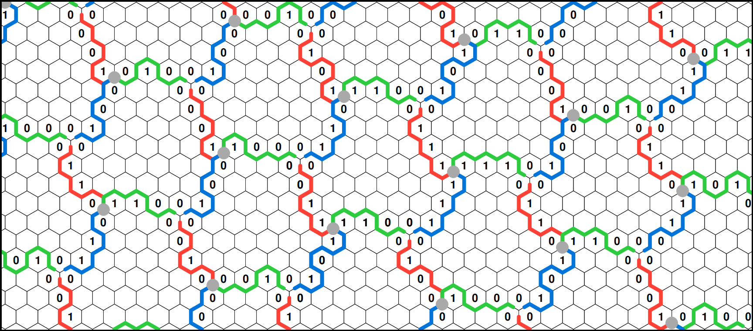
Irregular quasi-hexagonal lattice
Each triple-edge modifiers is randomly picked
Notes:
Each of these triple-edge modifiers is randomly picked from all possible perturbations.

Slide 21
Irregular quasi-hexagonal lattice
This construction guarantees equal capacity for all irregular hextiles
Notes:
Thus producing irregular hextiles of same capacities, that form an infinite lattice.

Slide 22
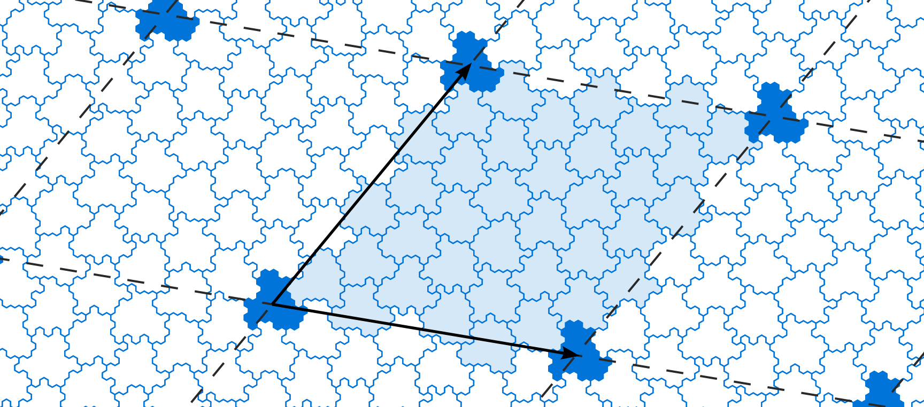
Irregular quasi-hexagonal lattice
Perturbation cover the plane through bi-periodicity
Notes:
To obtain a finite number of irregular hextiles,
we apply, in fact, the stochastic process to a finite set of hextiles in order to get a bi-periodic set of irregular hextiles.

Slide 23
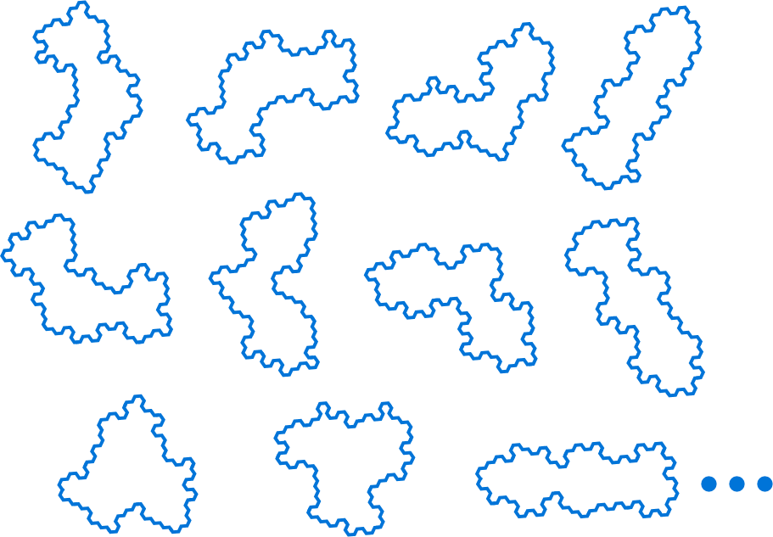
Irregular Polyhexes
Subdivision rule for each irregular trihex
11 ∙ λ possible irregular trihexes
Notes:
As before, to construct a hierarchical non-periodic tiling system, we enumerate all possible irregular trihexes on this lattice.
====
And for each of them, we construct a unique subdivision rule.

Slide 24
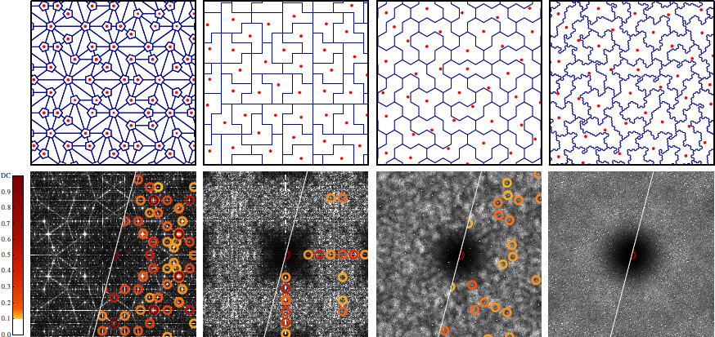
Comparison with previous systems
Penrose
Polyominoes
Trihexes
Irregular Trihexes
Notes:
By applying this set of deterministic subdivision rules, we achieve our goal of creating a non-periodic hierarchical tiling.
The distribution of tiles barycenters is now free of spectral peaks and is nearly isotropic.
Thus, this tiling system provides a good base to build a high quality sampling system.

Slide 25
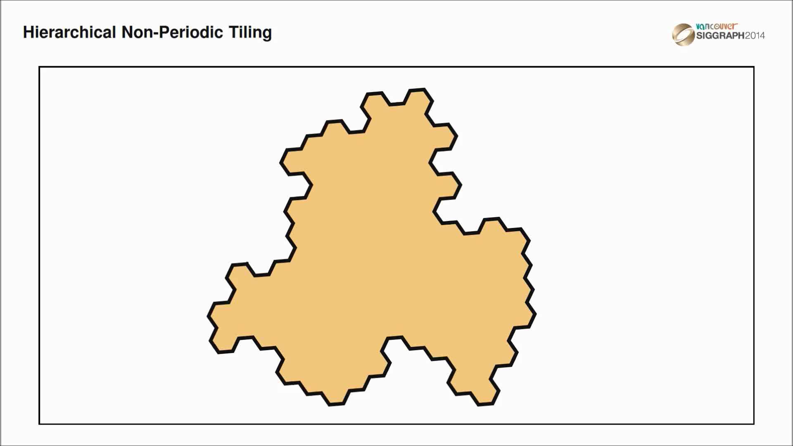
Sampling generation
Notes:
To construct a sampling distribution we start with an arbitrary irregular trihex, that we subdivide to reach the desired density.
From this tiling, we compute the barycenters of each tile to obtain our base sampling distribution.

Slide 26
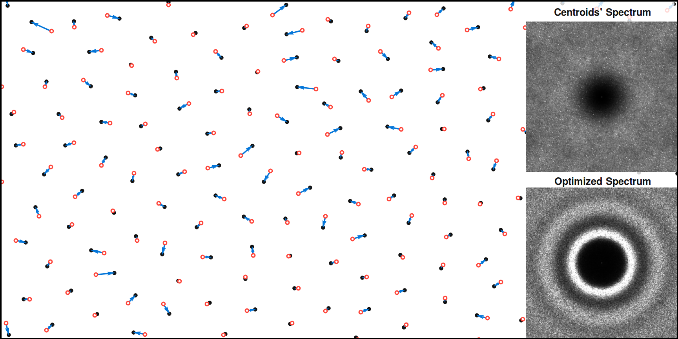
Sampling optimization
Notes:
To reach the desired spectral target, we need to optimize these barycenters.
Local offsets between tile barycenters and their optimized positions are then sufficient to shape the spectrum to the desired profile.

Slide 27
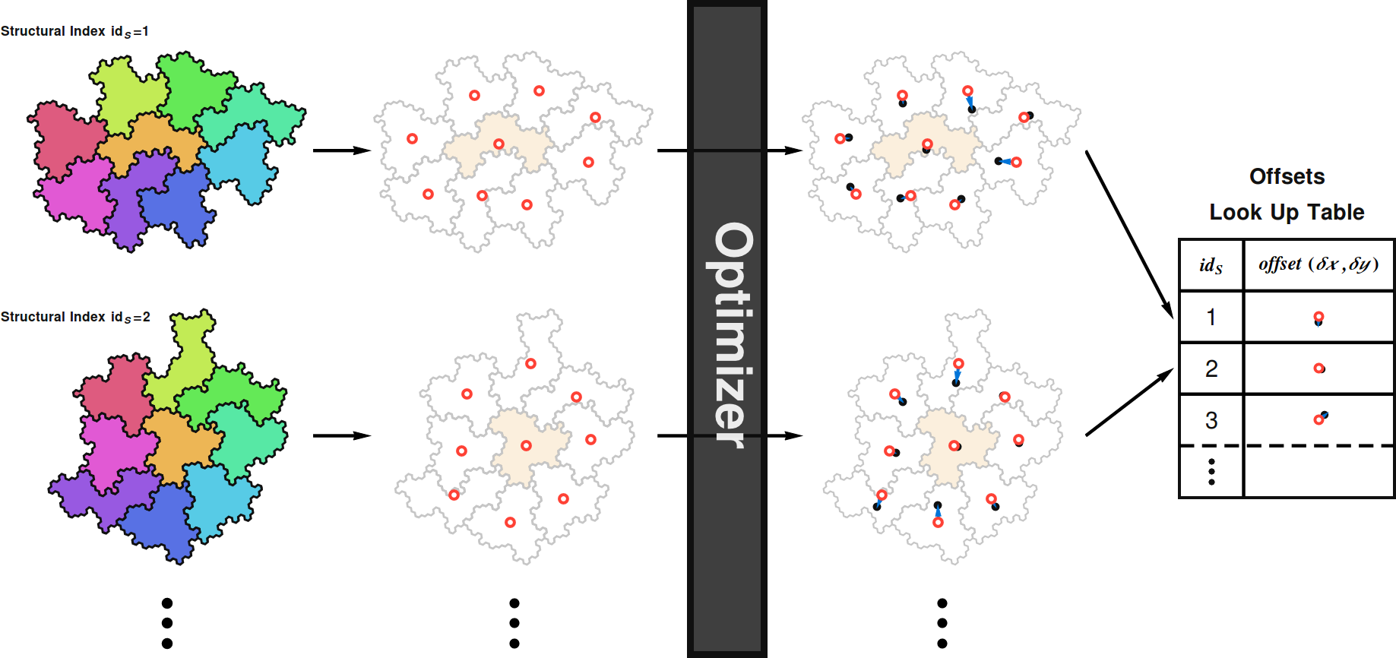
Sampling optimization
Notes:
To perform a full optimization, we generate a collection of patches from each irregular trihex in our library and their possible neighborhoods
Each such patch is characterized by an unique structural index and contains a set of tile barycenters to be optimized.
The offset between the base position and the optimized one is then stored in a lookup table and sorted by its structural index.
You can find details on this part in the paper.

Slide 28
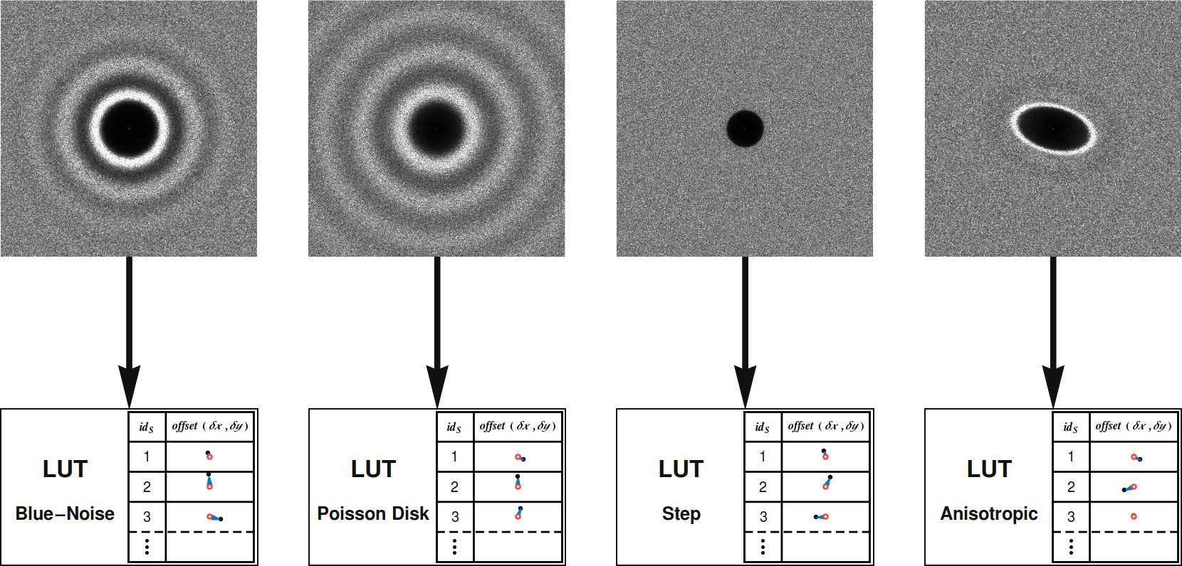
Sampling optimization
Notes:
Consequently, to attain different spectral targets, we need to produce different lookup tables.

Slide 29
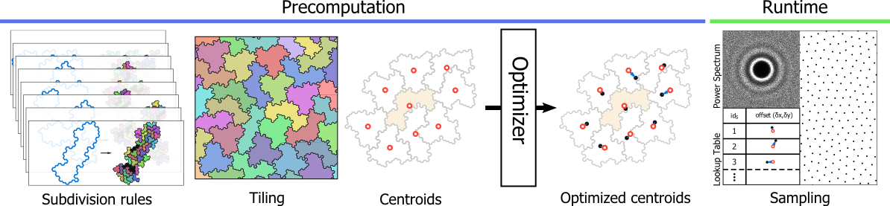
Overall pipeline
Notes:
In summary, our system requires a pre-computation phase before a fast sampling generation.
Subdivision rules allow us to generate a hierarchical non-periodic tiling where barycenters produce a basic sample distribution.
The offset vectors obtained from the optimization of these samples are then stored in a lookup table.
The sampling phase consist of two simple steps:
generating a tiling with the desired density,
and then adding the precomputed offset vectors to the barycenters of each tile.

Slide 30

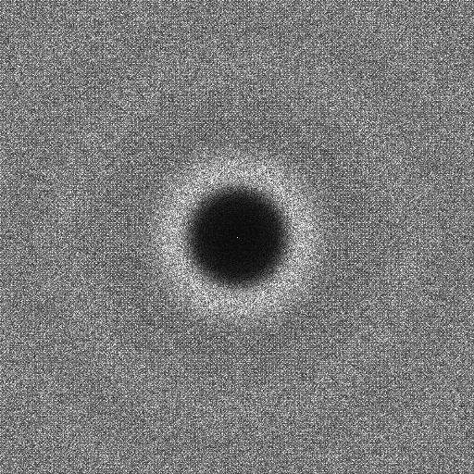

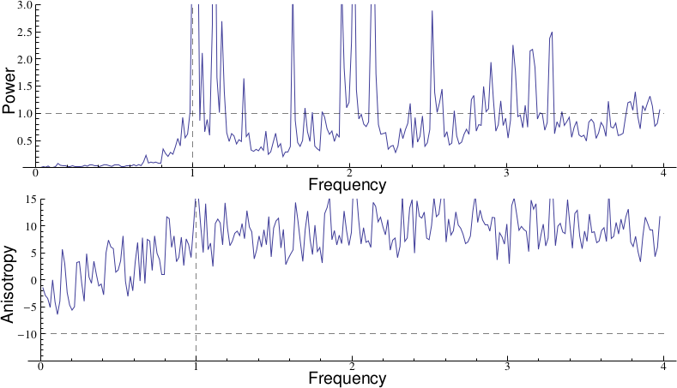
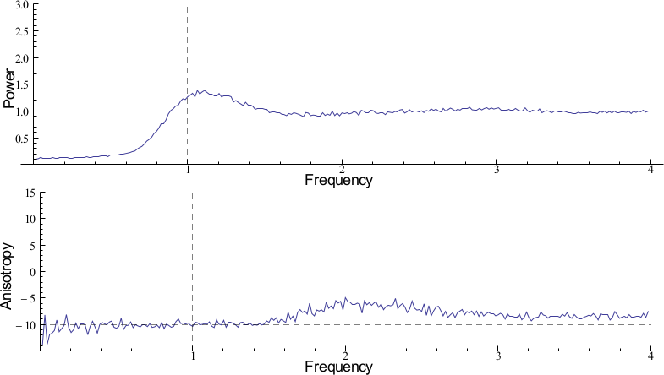

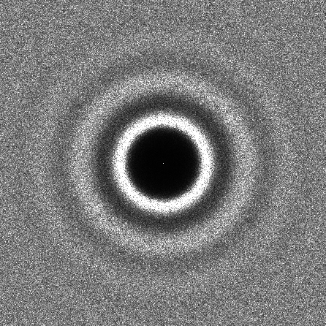

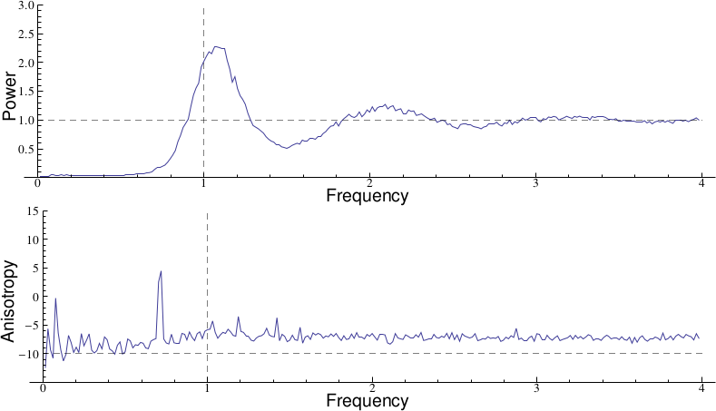

Results
Comparison with previous tile-based sampling methods
Penrose
Wang Tiles
Polyominoes
Our Result
Notes:
Compared to previous tile-based methods, this system produces blue-noise distributions of much better quality and without spectral peaks.

Slide 31




Results
Uniform blue-noise sampling
BNOT [De Goes et al. 2012]
Our Result
Notes:
In fact, for blue-noise sampling, we produce distributions of equivalent quality than the best state-of-the-art blue-noise methods.

Slide 32





Results
Uniform step-noise sampling
Step using [Heck et al. 2013]
Our Result
Notes:
We can also produce more specific distributions like this step function spectrum.
The result is equivalent to general noise methods.

Slide 33




Results
Examplar-based sampling
Empirical tree distribution in a forest from [Pommerening 2002]
Notes:
This spectral control allows us to reproduce real distributions.
Here we generate a forest with the same distribution properties than a real measured forest.

Slide 34
Results
Time in seconds to generate a distribution of N samples
Methods | 10k | 50k | 1M | 10M
CCVT | 157.000 | 4880.000 | - | -
BNOT | 6.000 | 65.000 | 10738.000 | -
General Noise (GPU) | 10.110 | 13.910 | 147.500 | -
Penrose | 0.730 | 4.550 | 11.800 | 80.400
Wang Tiles | 0.004 | 0.018 | 0.345 | 3.420
Polyominoes | 0.053 | 0.254 | 18.900 | 19.600
Ours | 0.016 | 0.067 | 0.989 | 9.280
Optimization-based Methods
Spectral control
Tile-based Methods
Notes:
In term of speed, more than a million points can be generated per second, as with previous tile-based methods.
It allow to generate high quality blue-noise distribution at lower complexity.
For example, we generate one million points five order of magnitude faster than Bnot algorithm.

Slide 35

Results
Adaptive blue-noise sampling
Notes:
By the hierarchical nature of the tiling system, it's possible to generate adaptive samplings where the density of sample is locally proportional to a density function.

Slide 36
Contributions
A Novel Tiling System
Centroid Spectrum Free of Spurious Peaks
Hierarchical
Non-periodic
A Novel Sampling System
Spectral Control
Adaptive
Fast ( > 1M points /sec. /core )
Supplementary material and source code: http://liris.cnrs.fr/polyhex
Notes:
To summarize our contributions:
First, we propose a novel hierarchical and non-periodic tiling system.
The key property of this system is absence of spectral peaks.
Second, we propose a novel sampling system which generates adaptive distributions with control over their spectral characteristics.
If you want additional information, you can get supplementary material and source code on this website.
Thank you.

